Slide 1
ELEMENTARY STATISTICS, BLUMAN
TI Calculator - Five Number Summary and Outliers
© 2019 McGraw-Hill Education. All rights reserved. Authorized only for instructor use in the classroom. No reproduction or further distribution permitted without the prior written consent of McGraw-Hill Education.

Slide 2
Objectives for this PowerPoint
Use the TI graphing calculator to find the Five Number Summary
Learn how to find any outliers that a data set might contain.

Slide 3
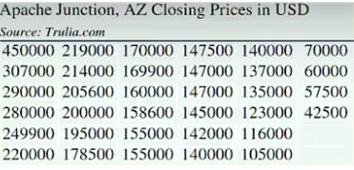
Data
The data in the table are the closing prices for homes in Apache Junction, Arizona for one month in 2017. They are arranged in descending order. We can see that the data spans from a minimum of $42,500 to a maximum of $450,000.

Slide 4
Five Number Summary (1)
One device that is used to examine the distribution of data in a data set is called the Five Number Summary. The Five Number Summary consists of the Minimum, 1st Quartile, Median, 3rd Quartile, and the Maximum value for the data set.
We will use the TI graphing calculator to find these measures.

Slide 5
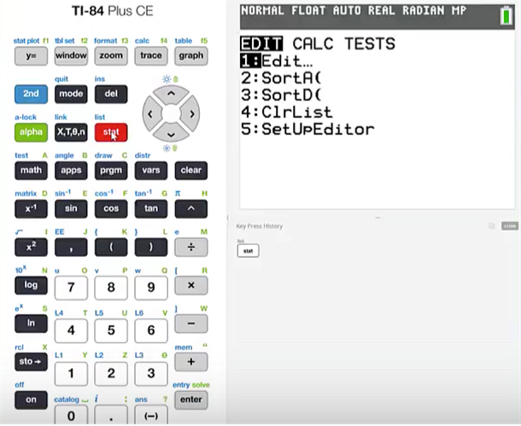
Five Number Summary (2)
In order to use the TI graphing calculator to find the Five Number Summary for a data set, we will have to first enter the data values into a list. We will do that by pressing stat and then 1: in order to edit a list.

Slide 6
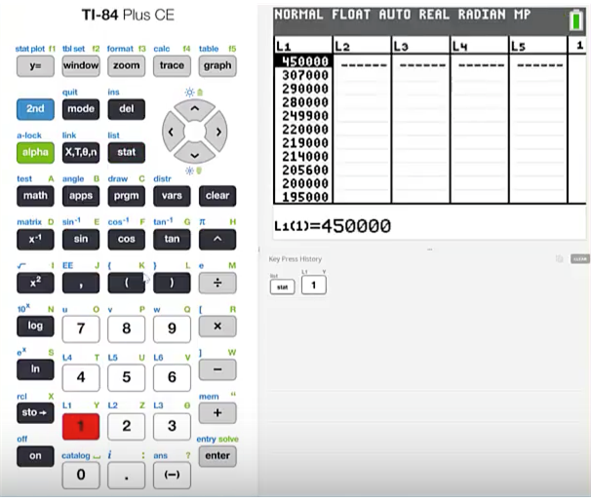
Five Number Summary (3)
The data values have already been entered into the list. Remember that you must press the enter button between each data entry.

Slide 7
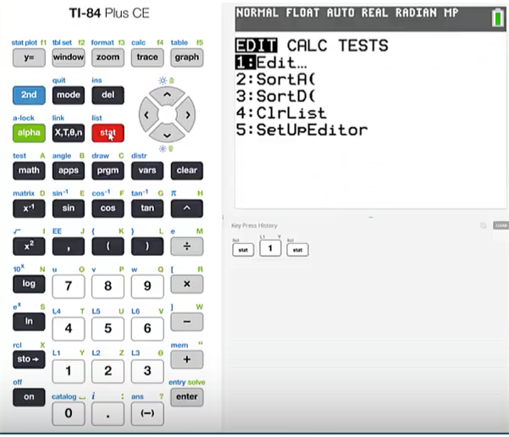
Five Number Summary (4)
To find the Five Number Summary press stat

Slide 8
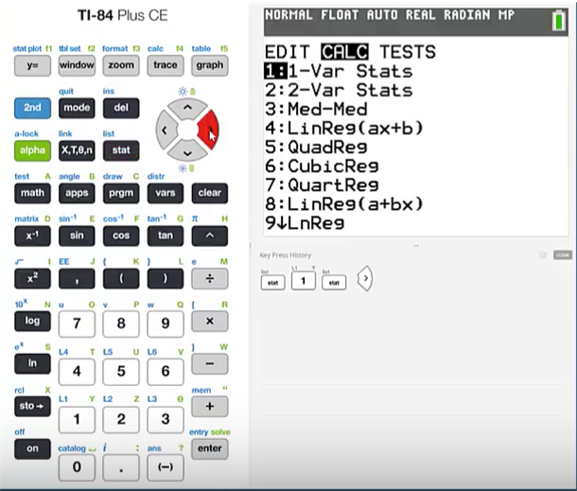
Five Number Summary (5)
Use the right cursor to go over to CALC and then press 1 for one variable statistics.

Slide 9
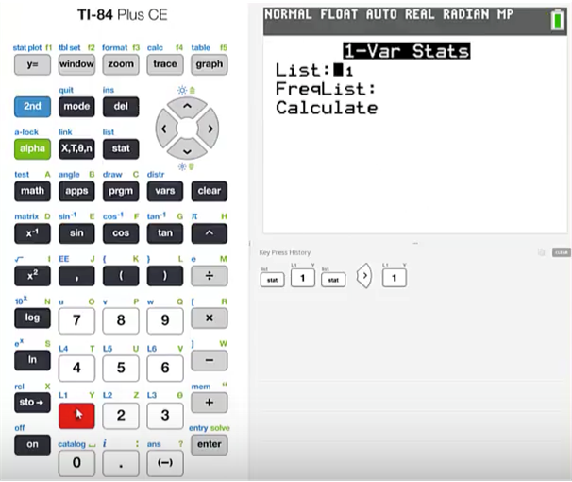
Five Number Summary (6)
Make sure to correctly specify which list contains your data values.

Slide 10
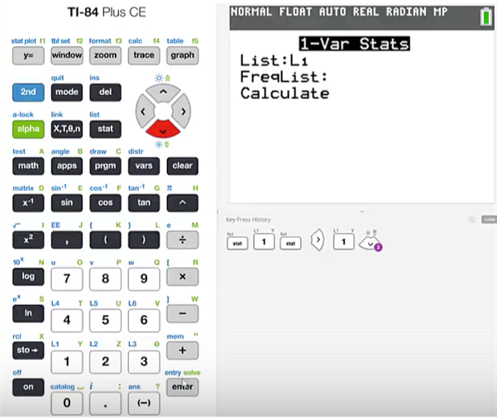
Five Number Summary (7)
Use the down cursor to get to calculate and then press enter.

Slide 11
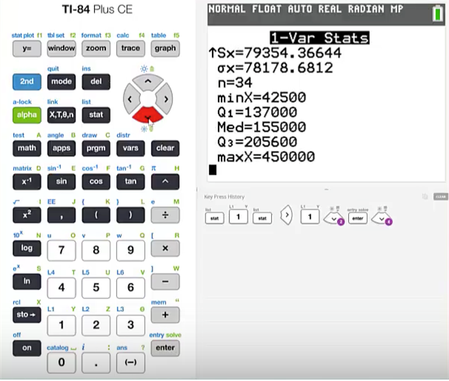
Five Number Summary (8)
Use the down cursor again, to access the Five Number Summary.
The minimum value is 42,500.
The 1st quartile is 137,000.
The median is 155,000.
The 3rd quartile is 205,600.
The maximum value is 450,000.

Slide 12
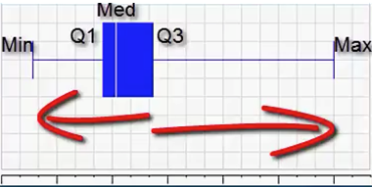
Box Plot
It is useful to exhibit the Five Number Summary graphically using a Box Plot. The Box Plot is scaled and uses vertical markers to show the locations of the values in the Five Number Summary. The horizontal axis is spaced evenly.

Slide 13
Draw Conclusions from Box Plot
We can draw conclusions about the distribution of the data. Notice that the location of the 3rd quartile shows that the bottom 75% of the data values, span a shorter range than the upper 25%. This would indicate that there is clustering towards the bottom of this data set; while the larger data values are more spread out.

Slide 14
IQR
We can also use the values in the Five Number Summary to help us determine whether or not the data set contains outliers. In order to make this determination we will begin by finding the interquartile range. The abbreviation for interquartile range is IQR. It is found by subtracting the 1st quartile from the 3rd quartile.
IQR = 205,600 – 137,000 = 68,600
Next we will multiply the IQR by 1.5
1.5 x 68,600 = 102,900

Slide 15
Interval
We will now calculate a left end point and a right end point of an interval. The left end point will be found by subtracting 1.5 times the interquartile range from the 1st quartile. The right end point will be found by adding 1.5 times the interquartile range to the 3rd quartile.
Left end point = Q₁ – 1.5*IQR = 137,000 – 102,900 = 34,100
Right end point = Q₂ – 1.5*IQR = 205,600 + 102,900 = 308,500

Slide 16
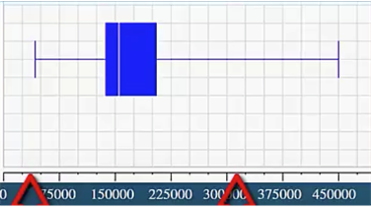
Place End Points on Box Plot
Place the values 34,100 and 308,500 on the horizontal axis. Anything outside of this interval could be considered an outlier. The minimum value is 42,500. There are no values less than the left end point of the interval. However, there is one value that is greater than the right end point of the interval. That value is 450,000.

Slide 17
Outliers
Sometimes an outlier is the result of an observational or recording error. This procedure makes it possible to sometimes detect these types of errors. The data set can then be corrected.

Slide 18
Summary
In this PowerPoint we learned how to use the TI graphing calculator to find the Five Number Summary. We also learned how to find any outliers that a data set might contain.

